Slide 1

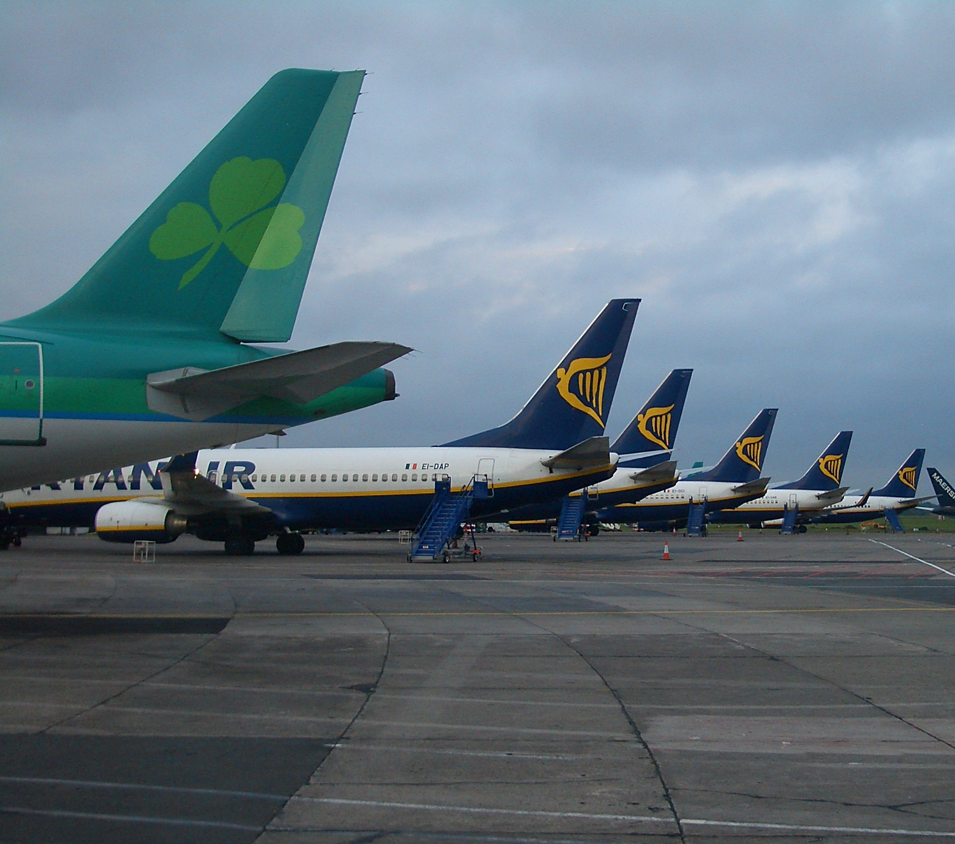
FLIGHT MANAGEMENT SYSYTEM
--
PRESENTED BY :-
Prathyusha VIDIYALA
Axis10JFSB1008
This Photo by Unknown author is licensed under CC BY-SA.

Slide 2
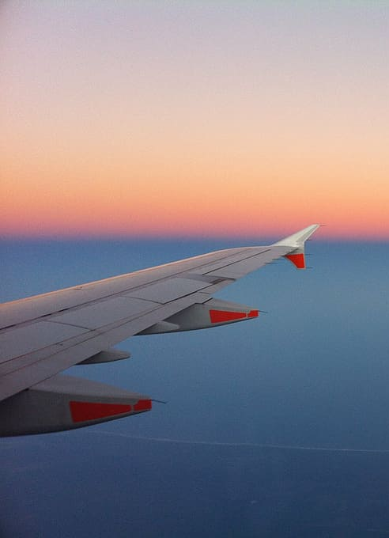
INTRODUCTION
FLIGHT MANAGEMENT SYSTEM is an application which enables the users to manage flights in an effective way.
The interactive GUI and ability to manage various flight details are the special features of this application
This app provides the feature to add the flight details and edit them when required and includes search operation as well

Slide 3
FLAWS IN EXISITING SYSTEM AND PROPOSED SYSTEM
In the older systems where the flight information is stored in one place and tickets information is stored in another place and for the flight booking where sometimes people manually go to the airport and buy the ticket considering the above and many other limitations the flight management system has been introduced
This Flight Management System gives us the feasibility to store the information of the flights for the admis and for the users can book their ticket by using this application

Slide 4
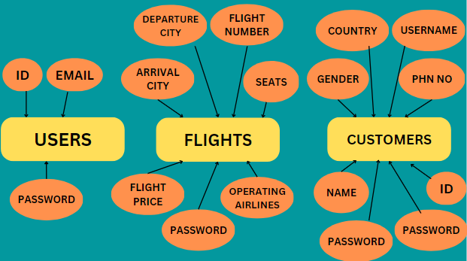




ENTITY-RELATIONSHIP DIAGRAM

Slide 5
APPLICATION FLOW
SIGN-UP
VALIDATION
LOGIN USING CREDENTIALS
POST INTO DB
​
ADDING FLIGHT DETAILS
PUT & DELETE
EDITING/DELETING FLIGHT DETAILS

Slide 6





TOOLS USED

Slide 7
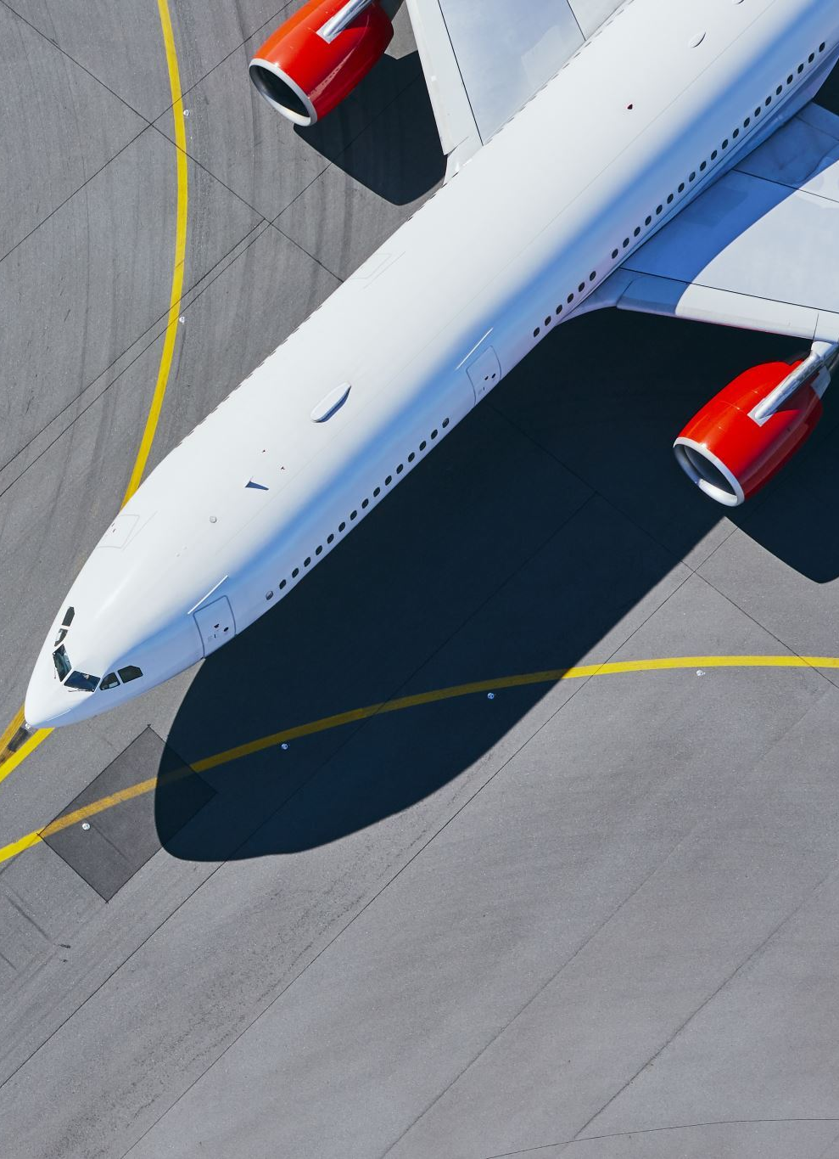
CONCLUSION
As we are heading into the time where efficiency and user convenience are the priority, this application provides us an effective way to Admins to manage the flights and for the users to book and travel in the flights.

Slide 8

THANK YOU FOR THE JOURNEY

